Slide 1
Welcome to the Web!
Mr Mack 2021

Slide 2
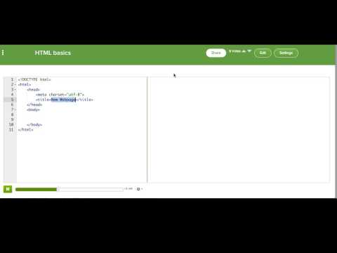
HTML Basics

Slide 3

Quick tip: HTML tags
Before you dive into the challenge, here's a quick review of HTML tags:
Notes:
The closing tag always comes after the content of the tag - it's how the browser knows that you want the tag to end.
The contents of an HTML tag are the stuff that goes between the opening and closing tags - this is what we mean when we say "inside" a tag. The contents of a tag can be normal text or a mix of other tags.

Slide 4
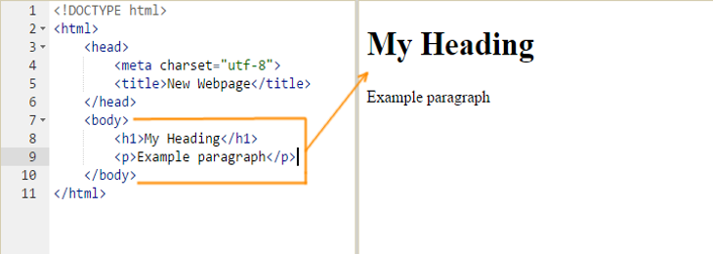
Where should your tags go?
Any content that is visible on your web page should go between the opening <body> tag and the closing </body> tag, like in the screenshot below:
Notes:
The <h1> and <p> tags are the contents of the <body> tag, so we say they're "inside" the <body> tag. In fact, those tags must go inside the <body> tag, so remember that when you're writing your HTML in your first challenge. Try it out now!

Slide 5
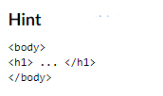
Practice 1
To practice the basics of HTML, let's have you write and markup a poem. To start off with, what will the title of your poem be?
Using the <h1> tag we learned about, add a heading for your poem. This will be your title.
Write a Poem

Slide 6
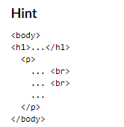
Practice 1
Now, below your heading, write the poem inside a paragraph tag. Your amazing poem should be multiple lines long, so you'll need to use a tag to make line breaks, too.
Remember that your <p> and <br> tags should be between the <body> and </body> tags.
Write a Poem

Slide 7
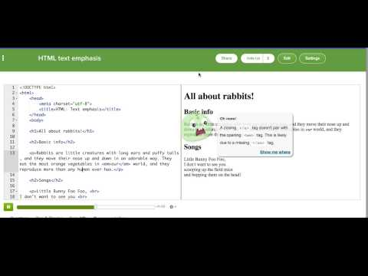
HTML: Text emphasis

Slide 8
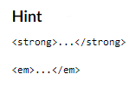
Practice 2
We've made this webpage with the words to 'You can learn anything', a video that Khan Academy made. Using both the <strong> and <em> tags that you just learned, mark up this text to show what you think should be emphasized and highlighted.
Add two of each!
You can learn text tags

Slide 9
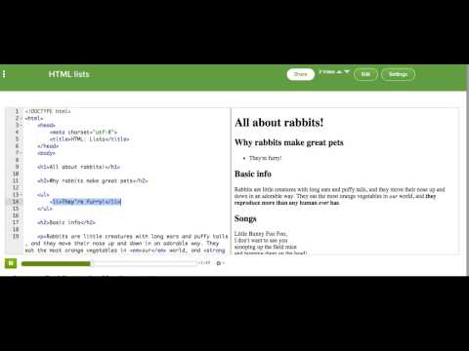
HTML: Lists

Slide 10

Practice 3
What do you wish for? In this challenge, you'll make a wishlist: a list of activities you want to do or things you want to have. To start off, write the HTML tag that creates a numbered list.
Wishlist

Slide 11
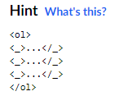
Practice 3
Now add items to your wishlist - at least three, but you can add as many as you wish for.
Wishlist

Slide 12
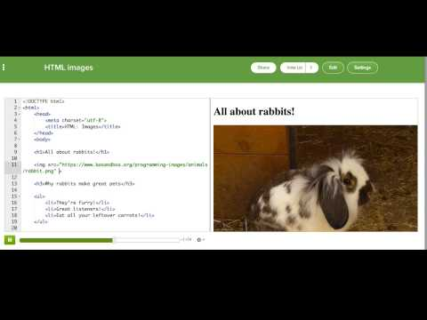
HTML: Images

Slide 13

Practice 4
If you could take the perfect trip, where would you go? What animals would you see? What food would you eat? Add images to this webpage after each paragraph tag, to share your perfect trip with the world.
A picture-perfect trip

Slide 14

Practice 4
We want you to experiment with the width and height attributes, so try adding them to your images.
A picture-perfect trip

Slide 15
Challenges

Slide 16


MOZILLA X-RAY GOGGLES
ACTIVITY
Using your school Google account signup to bit.ly/xrayGoggles
Once you have installed X-Ray Goggles on your bookmark bar.
Goto one of your favourite websites then turn on your x-ray goggles and explore the code behind the webpage.
SUCCESS CRITERIA
FINISHED
Understand that all webpages are made up of code.
Know the name of the code that used to add content to all webpages.
Challenge yourself to do more! Can you change your favourite movies website? Or change a musicians page to show they are playing at a local venue and for free!?
Publish your edit onto Google Classroom.
Help a neighbour!
Try to change an image on a webpage.
Credit to x-ray-goggles.mouse.org
Notes:
I would then demonstrate to the class how to first install Mozilla x-ray Goggles on their bookmark bar as some pupils sometimes struggle with this step. I would then go onto a website, not a news website as this is the next task. So I would normally use the school website and show them how to use Mozilla X-Ray Goggles to change text only. I would then ask pupils to go onto a website so that they can then try it themselves. I usually suggest changing a movie or musicians website or ticket website to show that they are playing at a local venue or they are giving away free tickets or something.
At some point I would bring the class back together and I would show them how to edit an image, so I would get them to do the steps with me one at a time. Then get them to try it themselves with another image. Some pupils find this a little bit tricker as the length of the code from an image can sometimes be quite long and sometimes they are not sure which piece of code to replace etc. There is instructions how to do this on the website, click here.
I give pupils time to explore and enjoy this task. They can try a few websites if they wish the kids usually really enjoy this task and I believe a good hock into a lesson is important so never want to rush parts that kids really enjoy. I would make them aware of opening and closing tags so they know what parts of the code they should edit and not delete so that their modification works.
If you’re unsure how to use Mozzilla x-ray Goggles yourself this YouTube video demonstrates how to install x-ray goggles and change elements https://www.youtube.com/watch?v=Gx63KznqGDc
OBJECTIVES
By completing this activity, students will:
Understand that all webpages are made up of code
Know the name of the code that used to add content to all webpages; HTML

Slide 17

HACK THE NEWS!
CREATE YOUR OWN FAKE NEWS USING HTML!
START HERE
Find a news article you wish to edit. This could be on BBC news, BBC sport etc.
Edit the content of the web page. Note you cannot edit videos.
In this activity, you will find a news article that you will edit. You will then make your own fake news article using x-ray goggles to edit the html on the page.
THINGS TO TRY
FINISHED?
Change the text on the article.
Pay attention to the small details. Change the date and time to make your article more believable.
Change the image that is displayed on the article!
Try designing a new costume for your sprite.
Take a screenshot of your fake news and post it on Google Classroom.
Help a neighbour!
Challenge yourself hack another page. Can you make something that might fool a family member, teacher or friend?
Credit to https://mozilla.github.io/mozilla-club-activity-hack-the-news/ for this activity.
Notes:
I love this task and pupils really seem to enjoy it as well. The challenge is to take what they know about how to edit the text and images and hack the news. Some pupils try to edit an image but it’s actually a video or a link. So I remind pupils that what they are looking for when the are trying to edit an image is the <img> that stands for image.
Ideas how to share pupils work...
It’s also important to let them know that they can’t save their changes but they can take a screenshot. This is a good opportunity to test the knowledge of pupils who completed the digital shortcuts lesson before this and see if they can remember what key to press to take a screenshot. If pupils are using the print screen button they can paste their project on Google slides and share this to the class. Or you could post a blank Google slide and make this accessible to the whole class and each pupil can take a new slide and paste their hacked news. Or show pupils how to use a the lightshot or snipping tool and save the image.
OBJECTIVES
By completing this activity, students will:
Become more familiar with editing html.
Be exposed to common html tags and the format of them; opening tag, content, closing tag.

Slide 18
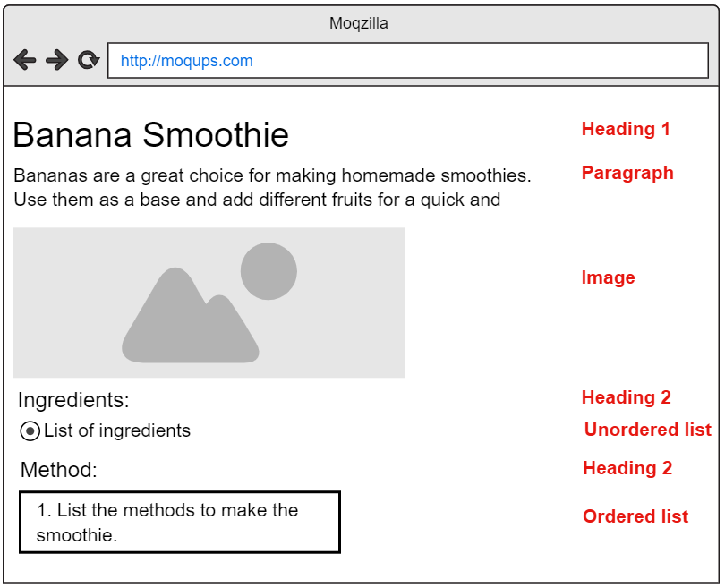
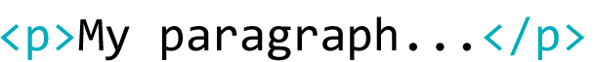
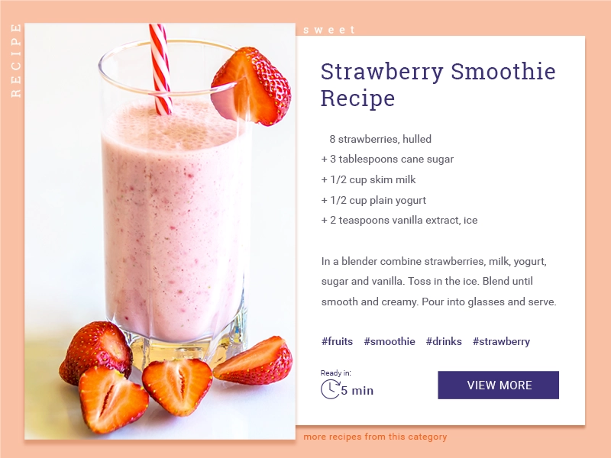
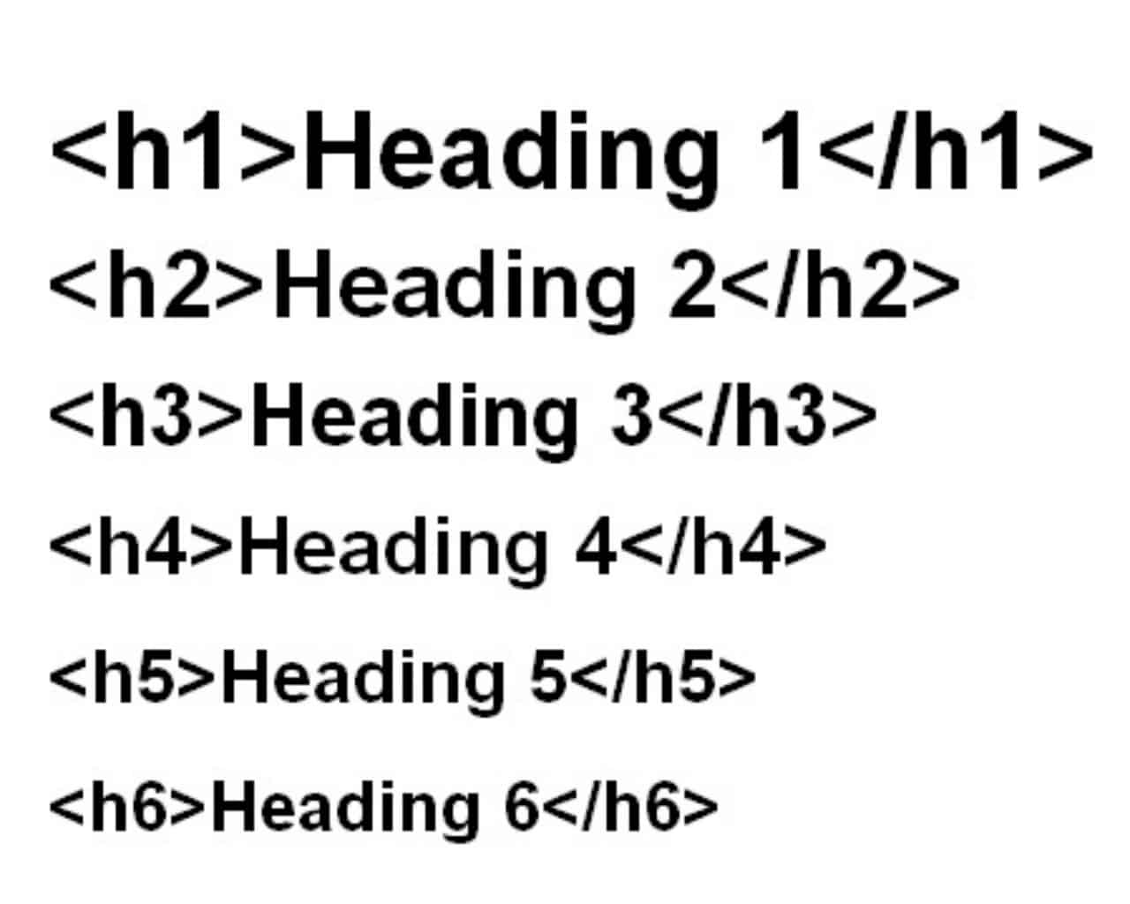
MAKE A RECIPE! (HTML)
CREATE YOUR OWN RECIPE CARD USING HTML!
START HERE
Open the Make a Recipe task
Using the HTML tags below create your own recipe card using the wireframe shown to the right to help you. Be creative!
In this activity, you will start to make your own recipe. You will be introduced to five common HTML tags; headings, paragraphs, image, ordered lists and unordered lists.
How to insert an image:
How to insert a paragraph
How to insert a heading:
How to insert ordered list and unordered list
FINISHED?
Publish your recipe on Google classroom.
Help a neighbour!
Challenge yourself! Research how to add a link to a website or insert a YouTube video.
Credit to Code Club projects for this activity.
Notes:
OBJECTIVES
By completing this activity, students will:
Become more familiar with editing html.
Be exposed to common html tags and the format of them; opening tag, content, closing tag.
I would then open the make a recipe template and explain as a class the lines of code and the importance of the order html, head, body etc. I would briefly touch on css but nothing complicated as I wouldn’t want to overwhelm them and would rather them get to grips with basic html code first before explaining css and potentially confusing them. Doing them separately as well really emphasises the point that html is just the content but css formats the content etc. I would also highlight to them the difference between an open and closing tag and where they would then start to code and the importance of the order. For example I would use a <h1> tag and write something then put a <p> tag and write something to show them that it would display the heading first then the paragraph. Then I would ask the class what I would do to the code so that it would show the text in the paragraph first then the text in the h1 tag afterwards. This is a simple but important point that the order of your code is important.
I would then display the slide above and give them the task. I would talk them through the website design on the right hand side and point out that the design tells them which piece of code to use for example the text “Banana Smoothie” is a heading 1 so they would need to use a <h1> tag. I would demonstrate by copying the code over to the html-template and showing them what happens if you run <h1>Heading 1</h1> tag. We would then discuss what they would change in the <h1> tag example on the slide to make it say Banana Smoothie, as sometimes when I have done this lesson pupils keep the words “Heading 1” in the code. I would discuss each piece of code; explaining about the different size of heading tags etc and that h1 is the biggest and h6 is the smallest. I would take time to talk about the ordered list and unordered list. The graphic illustrates this piece of code really nicely. Image code is really important as well as some pupils get a bit confused and delete maybe a quotation mark etc. or are unsure how to get the image url so this is something I would demonstrate with a few images and get them to do it with me with any appropriate image they would like before they start the task. Task - I would then check for understanding and then tell them that the challenge is to make a recipe webpage that follows the design at the right hand side. I let them pick any recipe they like it doesn’t have to be a banana smoothie it can be anything they like so long as it’s a recipe and follows the design.

